Slide 1
Release Planning in Agile
- Prof K G Krishna

Slide 2



Text/Reference Books
T1
T2
Compliments of IBM
➔ As this field is evolutionary, the student is advised to stay tuned to the current and emerging practices by referring to their own organization’s documentation as well as Net sources

Slide 3
Topics
Release Planning in Agile Methods
Characteristics of Agile Planning
Stages of Agile Planning
Release Planning

Slide 4
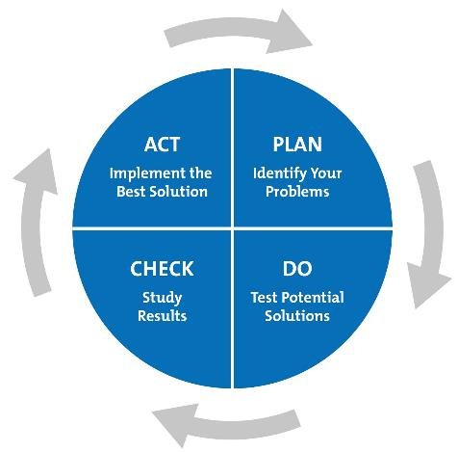
Planning is Continuous!
(Deming’s Continuous Improvement Cycle)
Planning is NOT a One-time Activity at the Beginning of a Project
Part of PDCA (Deming’s Cycle of Continuous Improvement)
PDCA vs. “Plan-the-Work, Work-the-Plan” (Waterfall Model)
Agile Planning
Just-In-Time Planning / “Situational Planning”
Agile Planning is Continuous throughout the Project

Slide 5
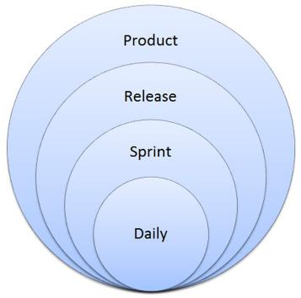
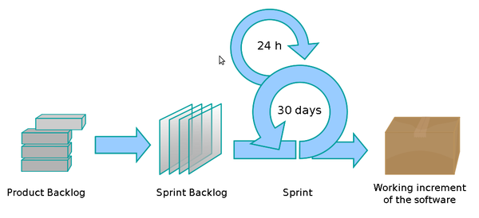
Levels of Planning in Agile
Product Vision (1 – 3 years)
Release Planning

Slide 6
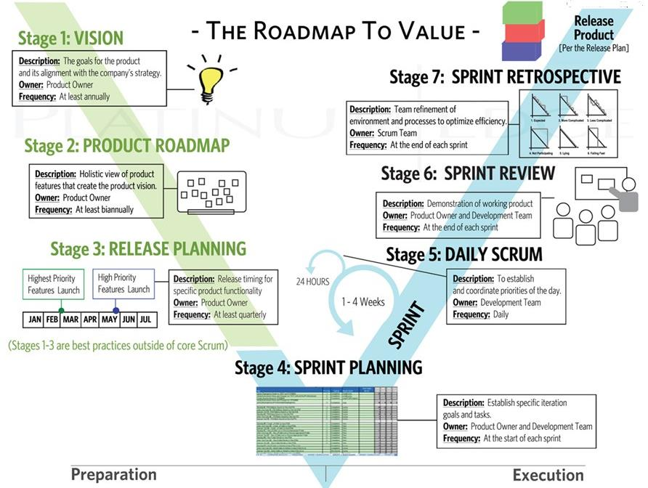
Planning at Every Stage in Agile (SCRUM)
Source: (T2)

Slide 7
Key Characteristics of Agile Planning
Planning occurs at every Stage
Planning, like Development is Iterative
Just-enough and Just-in-Time Planning at every Stage
Progressive Detailing - start with a broad plan and narrow it progressively
Prioritizing Value at every Stage: Add High-value Requirements first
Adapt the Plan after Feedback at every Stage
Plan-Do-Inspect-Adapt

Slide 8
Agile Release Planning Stages in Detail
➔➔

Slide 9
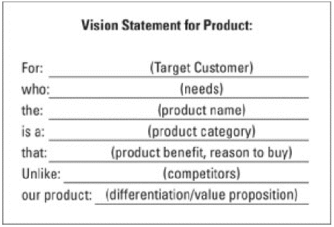
Stage-1: Defining Product Vision
The Vision Statement (Summary) communicating Product Strategy
Product Goals aligned with Strategy
Owned by the Product Owner
Frequency: annually (minimum)
Developing the Vision Statement
Develop the Product Objective
Draft the Vision Statement
Validate the Statement with Stakeholders and Revise after Feedback
Finalize the Vision Statement
The Vision Statement must be:
Clear with Simple language
Non-technical (everyone can understand)
Brief (in one or two lines)
Internally focused (at development, not a sales pitch)

Slide 10
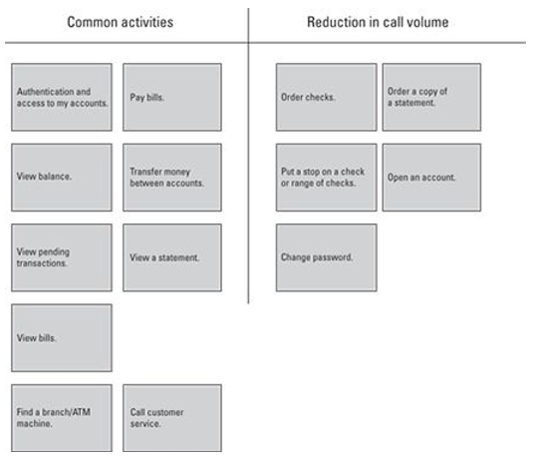
Stage-2: Holistic Product Roadmap
Derived from Project Vision
Identify Requirements that Define Product Roadmap
Arrange Requirements into Logical Groups
Estimate Effort and Prioritize Requirements
Set High-level Time-frame for each Group of Requirements
Beginning of the Creation of Product-Backlog
Update the Product Roadmap throughout the Project (unlike Project Vision)

Slide 11
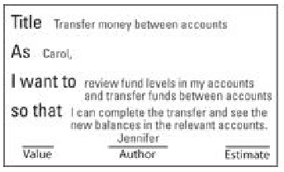
Stage-3: Release Planning
Elaboration of Project Roadmap into Details
A Release is a Minimum set of Marketable Requirements
Requirements Breakdown Structure (WBS) by granular Decomposition
“Epic-story ..→ User-stories”
User-story: Simple Description of Requirements (user-walkthrough or benefit statement)
Create Personas for each Class of Users
Identify each Story by ID and set a Value (in terms of benefits or priority)
Estimate Effort for each Story (“story points”)
Document on Index-cards or Post-it Notes
Product Owner manages the Stories
Break Stories further into detailed Features/Tasks for Sprint Planning,

Slide 12
Stage-4: Sprint Planning
A Sprint is a consistent (fixed-length ~ 1-4weeks) Iteration of Time in which Product takes Demonstrable Shape
Sprint Backlog: List of User-stories (prioritized) with detailed WBS and Time-estimates
Each Task to be completed in 1-2 days max (no over-committing, reduce Scope if necessary)
Task Done ➔ Developed, Integrated, Tested and Documented
Development Team work only on one Requirement (Story/Tasks) at a time
Only the Development Team can modify the Sprint Backlog
Each Sprint includes:
Sprint Planning (max. 2 hours at the beginning of every week)
Daily Scrum Meeting (standup meeting for 15-20mins)
Development (bulk of the effort in Sprint)
Sprint Review
Sprint Retrospective

Slide 13
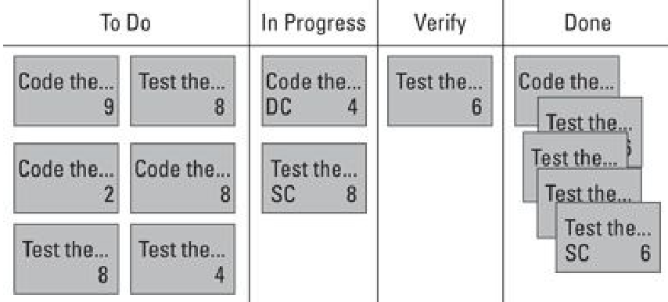
Stage-5: Daily Scrum
Each Day can be a Planning/Replanning Day (Daily Scrum meeting)
Daily Scrum Meeting to be Brief (~15-20mins Standup)
Scrum Master to facilitate the meeting (review progress, roadblocks,…)
Participants: Product Owner, Development Team and Scrum Master
Focus of Meeting: Coordinate/Prioritize (Not to solve Problems)
Update Sprint Backlog Daily (at the end of the meeting) and make it visible to everyone in the team

Slide 14
Stage-6: Sprint Review
Sprint Review Meeting at the end of each Sprint to review and demonstrate User-stories that were completed during the Sprint
Entire Team (Product Owner, Development Team, Stakeholders and Scrum Master) participates
Product Owner confirms Status of Completion of Sprint (ready for Release of partial-working product)
Invites Feedback from all Stakeholders
Scrum Master to update Product-backlog for the next Sprint Planning

Slide 15
Stage-7: Sprint Retrospective
Post Sprint Meeting (Scrum Master, Development Team and Product Owner) to discuss the experience of the Sprint – What went right and what went wrong
Focus is on Continuous Improvement of the Process to improve Efficiency and Velocity of throughput
Adapt Scrum Processes to improve morale of Team and their Work-life balance
Lasting for ~45mins maximum for every week of the Sprint
Opportunity to Inspect and Adapt (Plan-Do-Inspect-Adapt) Scrum Process

Slide 16
Preparing for Release
End of every Sprint to be Working and Demonstrable Product
A Sprint outcome can be a Release Sprint meant for Customers
Sprint-backlog Items in a Release Sprint might include:
Creating User Documentation for the just finished Release
Testing of Key Non-Functional Requirements (Performance, Security, Load balancing,…)
Compliance with mandatory Organizational or Regulatory Procedures
Integrating with existing Organization’s Enterprise Systems
Preparing Deployment Package (Installation scripts, etc)
Preparing a Release Note
Note that Development for Regular Sprint is different that of Release Sprint
Sprint Review meeting for Release to include Customer and Key Stakeholders from Marketing and Operations as well

Slide 17
Summary: Release Planning
Planning is Continuous in Agile – at every Stage in the Scrum Process (Release Planning, Daily Scrum, Sprint Review)
Each Release may span one or more Sprints
Agile Planning is planning for a pre-determined number of Releases to Customers
Planning for Release involves more Tasks (Sprint-backlog) than for regular Sprint
Sprint Retrospective Meeting identifies Opportunities for Improvement in the Scrum Process and implements them before the next Sprint cycle
More Meetings, More Sharing of Information/Feedback, Near-Real-Time Visibility into the Product, and finally ‘Unsurprising’ and Acceptable Product Release(s)!

Slide 18
Thank You
© Copyrights of original Authors are duly acknowledged
™ ® All Trademarks, Registered Trademarks referred in this document are the property of their respective owners

